Slide 1

Buck converter basics September 2024 Matisse BOFFY – Analog Field Applications Engineer ( +33 6 86 36 88 47 | * m-boffy@ti.com
Notes:
The choice of using a non-isolated buck converter topology to reduce a distribution voltage to a lower one for point-of-load applications is an easy one.
The buck is simple, has relatively few components and may be configured for a wide variety of applications.
The choice of how to manage the control of the converter is not quite as straightforward a decision

Slide 2






About me
Cpe Lyon engineering school Master’s degree
Electronics & embedded systems
Graduated in 01/2023
emlyon Business School Master’s degree
Management
Graduated in 01/2023
Joined Texas Instruments as Analog FAE
2016
2018
2020
2021
2022
2023
2024
Responsible for Aerospace and Defense customers
Current sense PCB design internship - Paris
BDC / BLDC control internship - Netherlands
Fab-Lab co creation - Lyon
Marketing internship - London
Notes:
More details on experiences
Why I chose TI + connection with past

Slide 3
Agenda
Texas Instruments overview + 2025 internship (PFE) offers
Step down technologies : LDO versus switcher
Focus on buck converter
TD : Buck components selection

Slide 4
Texas Instruments overview

Slide 5





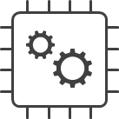

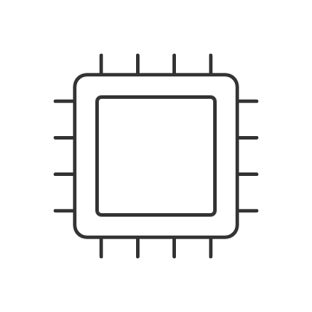




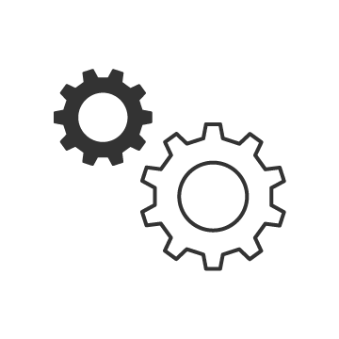

TI at a glance
PORTFOLIO
Analog Power Products
Analog Signal Chain
Embedded Processing
DLP® Products
Key markets
Industrial
Automotive
Personal electronics
Communications equipment
Enterprise systems
Technology and manufacturing
Supply continuity
Multi-sourcing
On-time delivery
200-mm
300-mm
Quality and reliability
Support
Easy part selection
Reference designs
Online
support
Training
Technical sales and support
Buy on TI.com

Slide 6

We offer products for any system
Sensors
Amplifier
Data converter
Interface
Protection
Power management
ESD/EMI
Buck DC/DC switching regulators
Boost, multichannel/ phase DC/DC
Linear power
Power switches, interface & lighting
High-voltage power
Battery management
Temperature
Radar
DLP® products
Wireless
connectivity
Embedded
processing
Current
Magnetic
Motor drives
Humidity
Specialty
Switches & multiplexers
Data converter
Clock &
timing
Amplifier
Voltage translation
Logic

Slide 7



Slide 8
Internship offers – Texas Instruments Paris
[Automotive] Improvement of Automotive Battery Management System (BMS)
[Automotive] Next generation of Automotive lighting design
[Aerospace and or Medical] Low noise power supplies for medical/aerospace/robotics applications
[Automotive] Self-cleaning camera system
If successful during your internship it may lead to you being hired as a graduate Analog Field Applications Engineer in 2025.
If interested, contact Matisse Boffy ( +33 6 86 36 88 47 | * m-boffy@ti.com

Slide 9
Voltage step down solutions I have 30Vin and I want 5Vout; what should I use ?

Slide 10
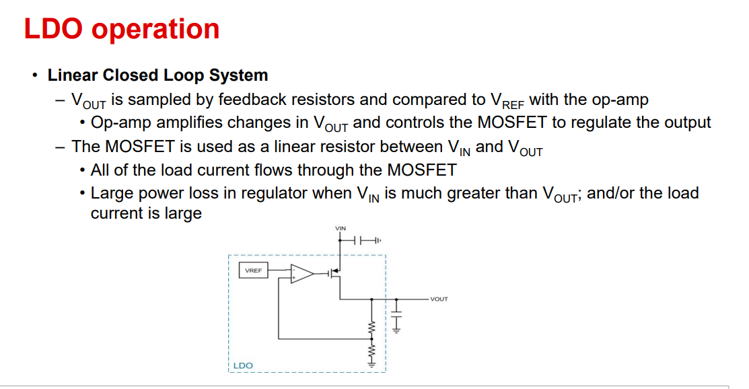

Slide 11
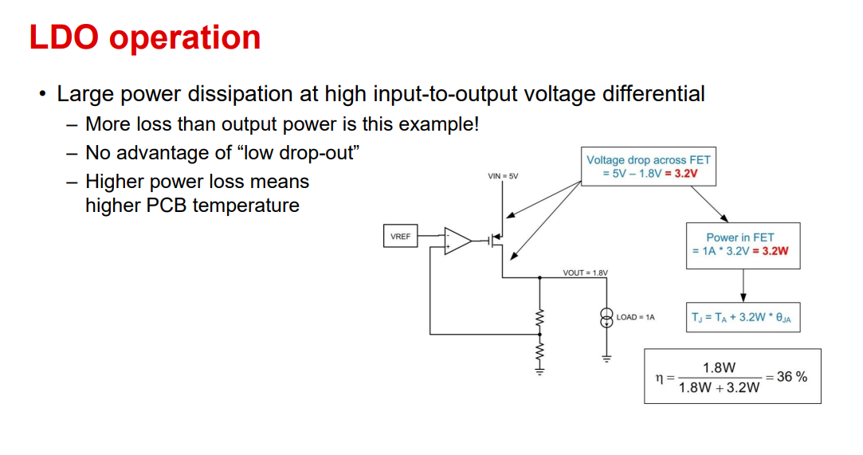

Slide 12
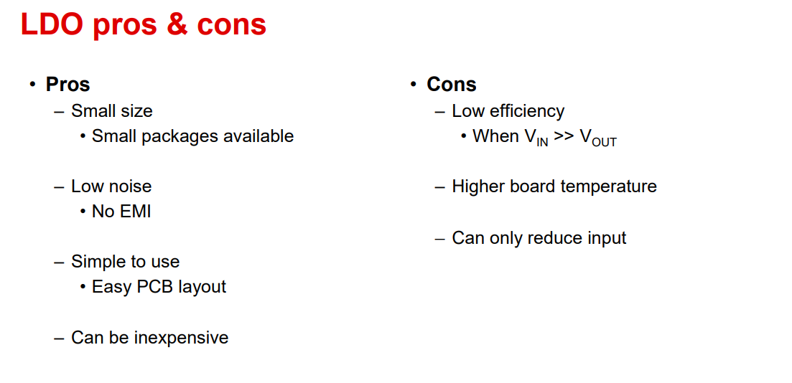

Slide 13
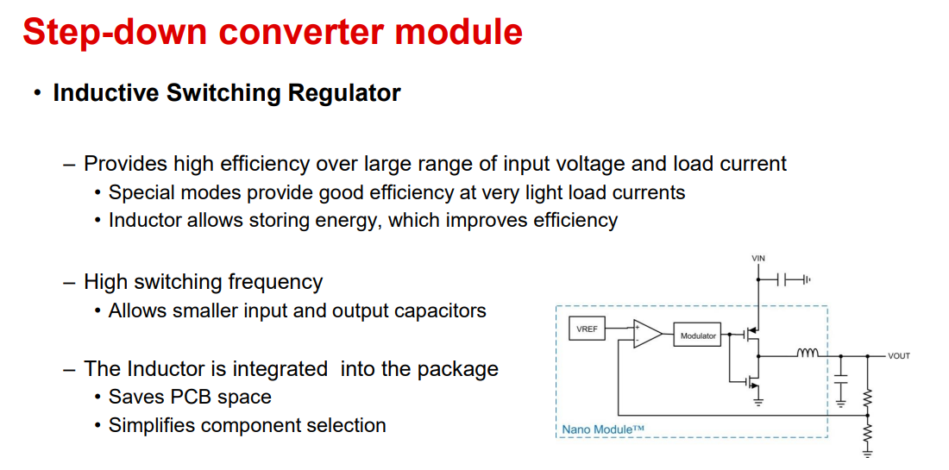

Slide 14
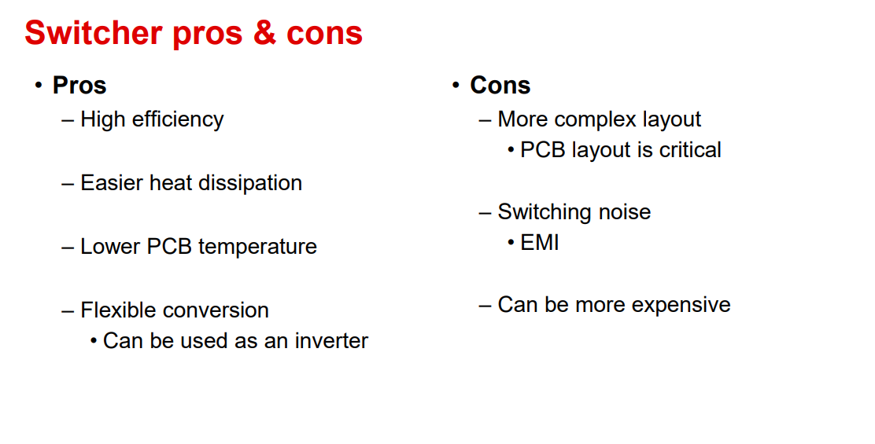

Slide 15
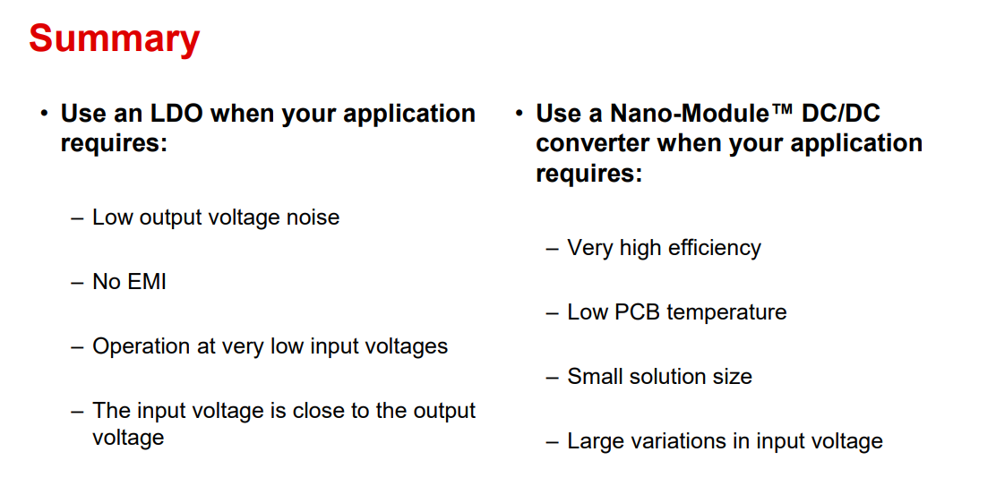

Slide 16
Deep dive on the buck converter

Slide 17
Basic elements of a buck converter
Power stage – feedback loop - compensation
Notes:
17
17
17
Feedback is needed to regulate the output voltage against input/output variations and transients.
Loop gain is the gain around the feedback loop, made up of the product of the error amp gain and the power stage gain.
Compensation is used to adjust the loop bandwidth and tailor the frequency response.
The bandwidth of the control loop determines the speed of the loop in responding to a transient condition.

Slide 18
Buck power stage
“Chop up” the input voltage
Sent to averaging filter
Vout is then proportional to Vin & duty cycle
1-3
Notes:
A buck converter operates by applying a pulse width modulated (PWM) waveform of a controlled duty cycle to a low pass L-C filter, thus converting one voltage to a lower one.
The switch is turned on and off connecting the input voltage to the inductor of the filter when on, and disconnecting it when off. The ratio of the on time of the switch to the switching period is called the “duty cycle”.
The low-pass filter averages the switching voltage, resulting in a relatively constant DC voltage at the converter output.
The input voltage and the duty cycle of the switch determine the output voltage.
The equation shows the Vout to Vin relationship for an ideal (loss-less) buck converter.

Slide 19
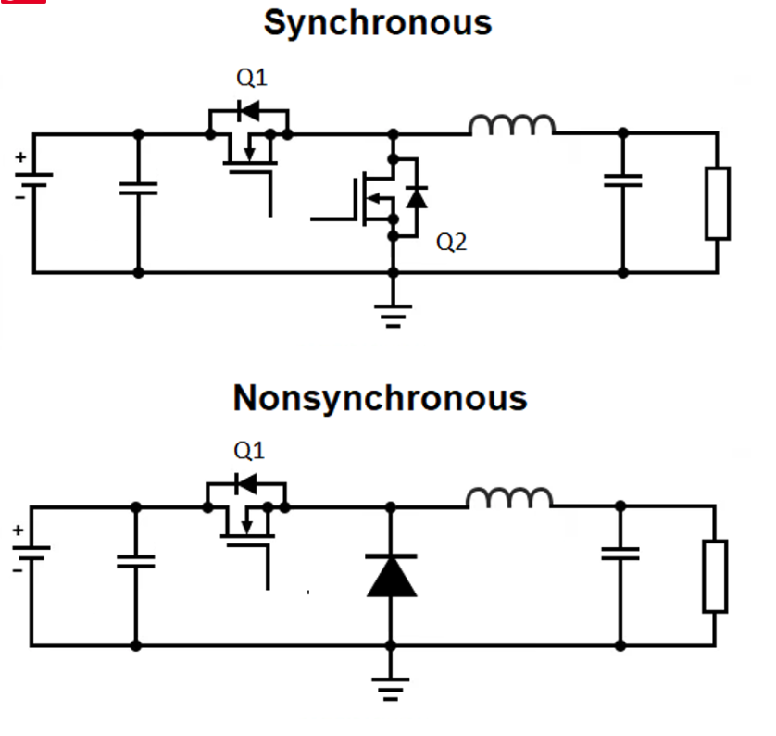
Power stage options

Slide 20
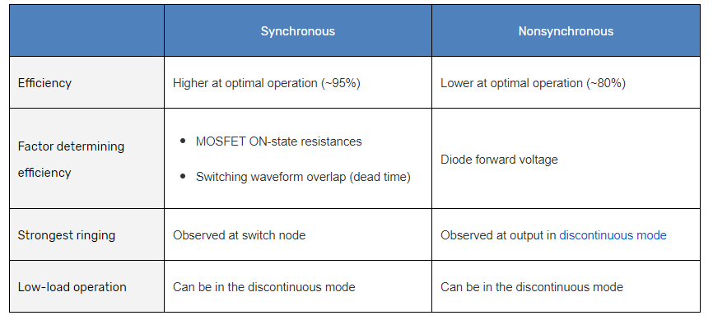
Power stage options

Slide 21
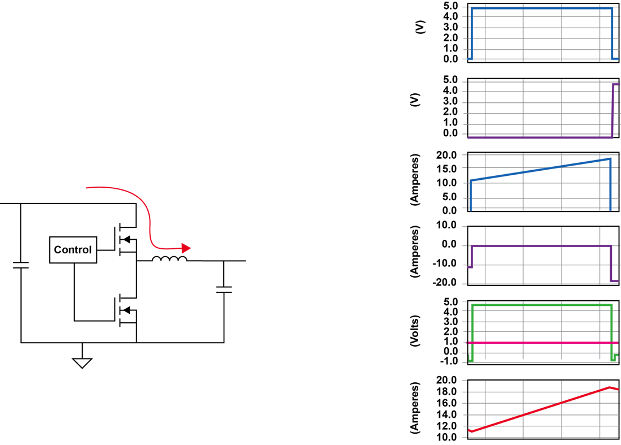
Buck power stage waveforms
HDVR turn ON – LVDR is OFF
HDVR
=Power transfer to the inductor
LDRV
I_{SW}
HDVR
I_{SR}
SW
LDVR
V_{OUT}
I_{L}
1-6
Notes:
Switch FET is ON, SR is OFF
Current builds in the inductor according to (vin-vout)/L – replenishing energy in the output capacitor

Slide 22
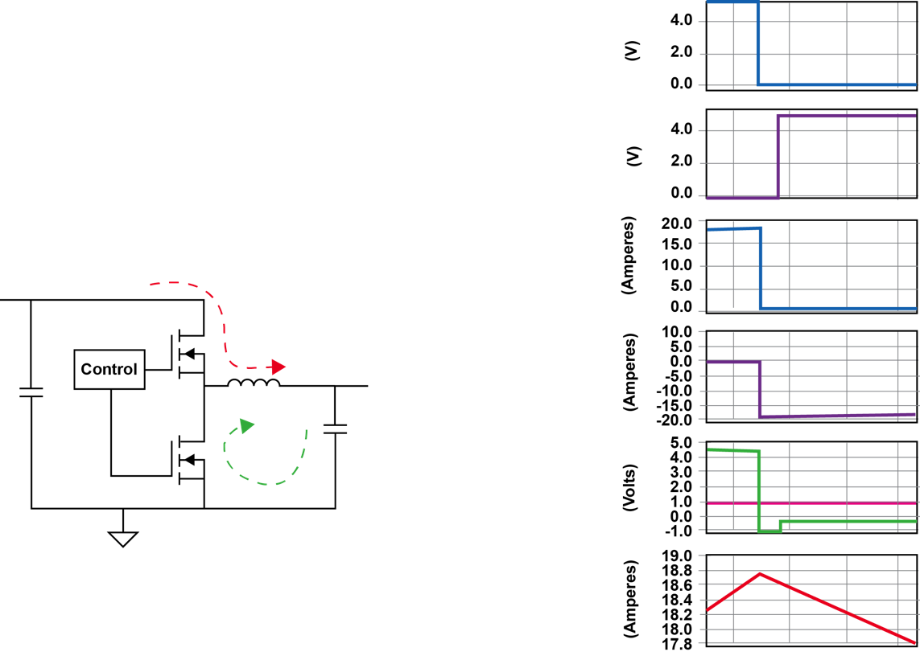
Buck power stage waveforms
HDVR turns OFF – LVDR turns ON
HDVR
LDRV
I_{SW}
HDVR
I_{SR}
SW
LDVR
V_{OUT}
I_{L}
1-7
Notes:
The PWM signal turns OFF the switch, and the inductor current begins to transition to the body diode of the SR.
The SW node voltage falls below Vout and the current in the SR and in the inductor begins to decrease.
The transition is complete and the inductor current continues decreasing. At this time, the current is still fully in the SR body diode.
The gate signal driving the SR turns ON the SR and the current transitions from the body diode of that MOSFET to its channel.
Evidence of this is the SW node going closer to GND than the body diode voltage of the MOSFET had allowed.

Slide 23
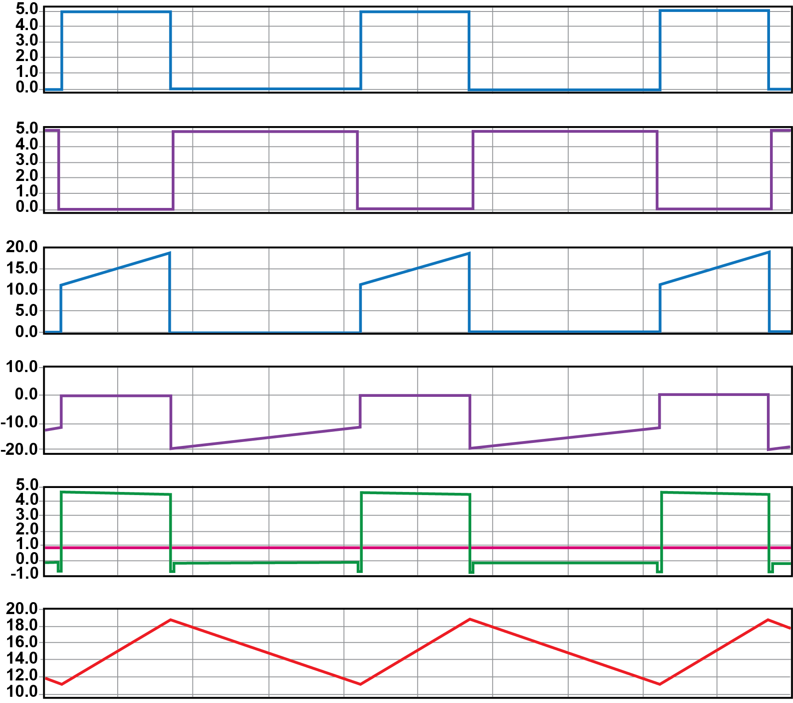
Buck power stage waveforms
(continuous conduction mode operation)
HDVR
LDRV
I_{SW}
I_{SR}
SW
V_{OUT}
I_{L}
1-4
Notes:
The duty cycle is defined as the ratio of the main switch ON time to the total switching period.
This relationship holds as long as there is continuous current flowing in the inductor, or in “Continuous Conduction Mode” (CCM).
There is another mode, called “Discontinuous Conduction Mode” (DCM), which will be discussed later.
In the next few slides, we will be going into details of a buck converter switching cycle. While unnecessary for general control purposes knowing some of these details can be helpful when you are debugging a design on the bench.

Slide 24
Buck compensation
Why do we need feedback?
Feedback is needed to regulate the output voltage
The bandwidth of the control loop determines the response time and the maximum deviation
The control loop must remain stable.
Notes:
24
24
24
Feedback is needed to regulate the output voltage against input/output variations and transients.
Loop gain is the gain around the feedback loop, made up of the product of the error amp gain and the power stage gain.
Compensation is used to adjust the loop bandwidth and tailor the frequency response.
The bandwidth of the control loop determines the speed of the loop in responding to a transient condition.

Slide 25
Stability : Phase margin and gain margin
Phase margin and gain margin
Sufficient phase margin is needed to prevent oscillation (45º min – aim for 60º )
Gain margin goal of 10 dB min to prevent switch node jitter
Slope of –20 dB/decade when passing through 0 dB
Phase margin
Gain margin
Notes:
Sufficient phase margin is required to prevent oscillations.
Phase margin of 45 degrees or greater is the design goal. A phase margin of 52° is critically damped, while 60° is considered good margin for a production design.
Low phase margin causes the response to be under-damped, while higher phase margin leads to an over-damped response.
Generally higher crossovers are preferred but there are practical limitations. Rule of thumb is 1/5 to 1/10 of switching frequency.
The attenuation at 0 degrees is referred to as gain margin. 6 dB is the minimum, while 10 dB is considered good.
Attenuation at the switching frequency is also important for noise immunity to minimize jitter.

Slide 26
What are the specifications you should look for ?
Maximum Input Voltage | 36V
Nominal Input Voltage | 30V
Output Voltage | 5V
Output Current | 2.5A
Targeted Efficiency | 92%
Output voltage ripple | < 5%
Output voltage variation during 50% to 100% load steps | < 5%
Switching frequency | 200kHz
Maximum inductor current ripple | 30%

Slide 27
Efficiency
Eff= P(out)/ P(in)
What dictates efficiency ?
FET
Conduction losses
Switching losses
Inductor & diode
Conduction losses

Slide 28
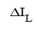
What is inductor current ripple and why it matters?
I_{L}
Higher peak currents
Higher inductor losses
More stress on power components
Additional output voltage ripple
Select the inductance value to keep the current ripple between 15% and 40% of the full load current level.
1-16
Notes:
The inductor and capacitor form a low pass filter, converting a switching waveform into its averaged equivalent (DC) plus a small amount of output noise.
The fundamental portion of the noise is created by the ripple current in the inductor.
The voltage impressed across the inductor ( V_{IN}-V_{OUT}) when the upper switch is on, induces current to build in the inductor. During the time when the upper switch is off, the inductor current decays at a rate determined by the output voltage plus the drop across the rectifier (V_{R}). With fixed frequency operation the design of the inductor is straightforward.
With a variable frequency control approach the filter is also a contributor to the basic function of the converter. Consider a hysteretic control technique: The ON time of the switch is terminated when the output voltage reaches an upper regulation threshold, and the off time is terminated by the output voltage reaching a lower threshold.
A variation of hysteretic control fixes the on time of the switch (called “Constant On Time” or COT control) and requires the off time to vary to maintain regulation. Similar to the hysteretic converter, the output capacitor impedance characteristics must be known to ensure the inductor current rise time is consistent with the ON time for the desired operating frequency and regulation voltage.
Notice that if the input voltage were to vary, the fixed frequency controlled converter would experience a change in duty cycle and a change in the peak to peak ripple. The variable frequency control technique maintains a fixed amount of ripple and results in a change in operating frequency.
When losses increase due to an increase in the load current, the resulting duty cycle increase to maintain output voltage regulation will cause a slight increase in the peak to peak ripple due to the increased duty cycle for the fixed frequency converter. For a Constant On Time converter, the increase in losses due to a load increase tends to increase the operating frequency.

Slide 29
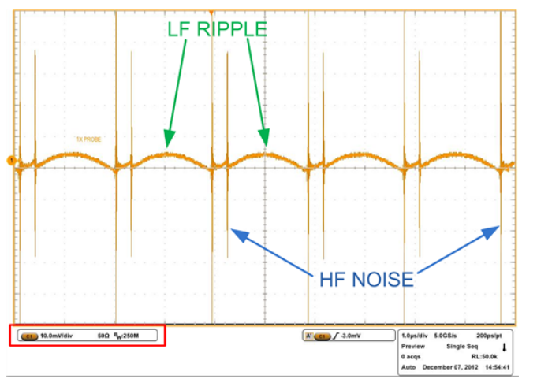
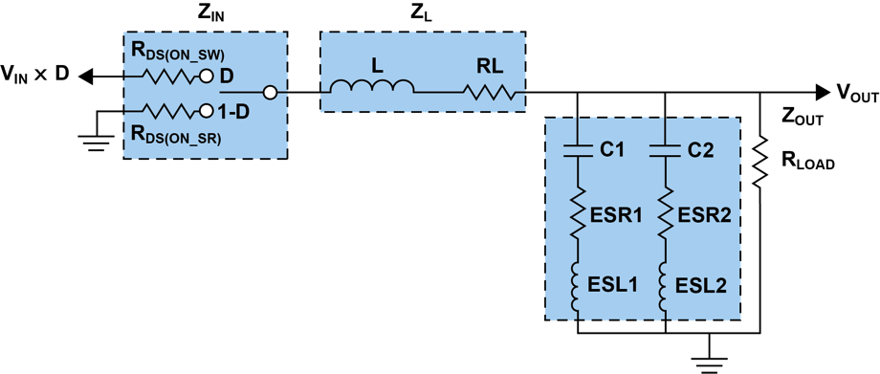
What is output voltage ripple and why it matters?
Low frequency voltage ripple
Function of the inductor ripple current going through the output capacitor’s impedance ( Capacitance + parasitic ESR & ESL)
Ac coupled Vout
Can damage downstream loads
Understanding, Measuring, and Reducing Output Voltage Ripple
Notes:
29
The control loop transient response to a disturbance is determined by the bandwidth and frequency response. The objective is to maximize the crossover frequency for fastest transient response. The gain and phase margin are adjusted for best settling behavior.

Slide 30
What is output voltage ripple and why it matters?
Low frequency voltage ripple
Function of the inductor ripple current going through the output capacitor’s impedance ( Capacitance + parasitic ESR & ESL)
How to reduce the low frequency voltage ripple
Increase the switching frequency (tradeoff is more switching losses, hotter solution and lower efficiency)
Increase the inductance to achieve lower current ripple (tradeoff is larger physical size).
Use output capacitor(s) with lower impedance at the switching frequency. Paralleling output capacitors is an effective way to achieve this.
Ac coupled Vout
Understanding, Measuring, and Reducing Output Voltage Ripple
Notes:
30
The control loop transient response to a disturbance is determined by the bandwidth and frequency response. The objective is to maximize the crossover frequency for fastest transient response. The gain and phase margin are adjusted for best settling behavior.

Slide 31
What is output voltage ripple and why it matters?
High frequency voltage ripple
Switch node couples with the output inductor parasitic capacitance
Gets worse with bad board layout
How to reduce HF voltage ripple
Good board layout of the power stage components
Any parasitic inductance in the current loop will result in voltage spikes.
Making the area of this high di/dt loop as small as possible will result in parasitic inductance that is as small as possible.
Can also be a measurement error. Use tip/barrel probe only
Ac coupled Vout
Understanding, Measuring, and Reducing Output Voltage Ripple
Notes:
31
The control loop transient response to a disturbance is determined by the bandwidth and frequency response. The objective is to maximize the crossover frequency for fastest transient response. The gain and phase margin are adjusted for best settling behavior.

Slide 32
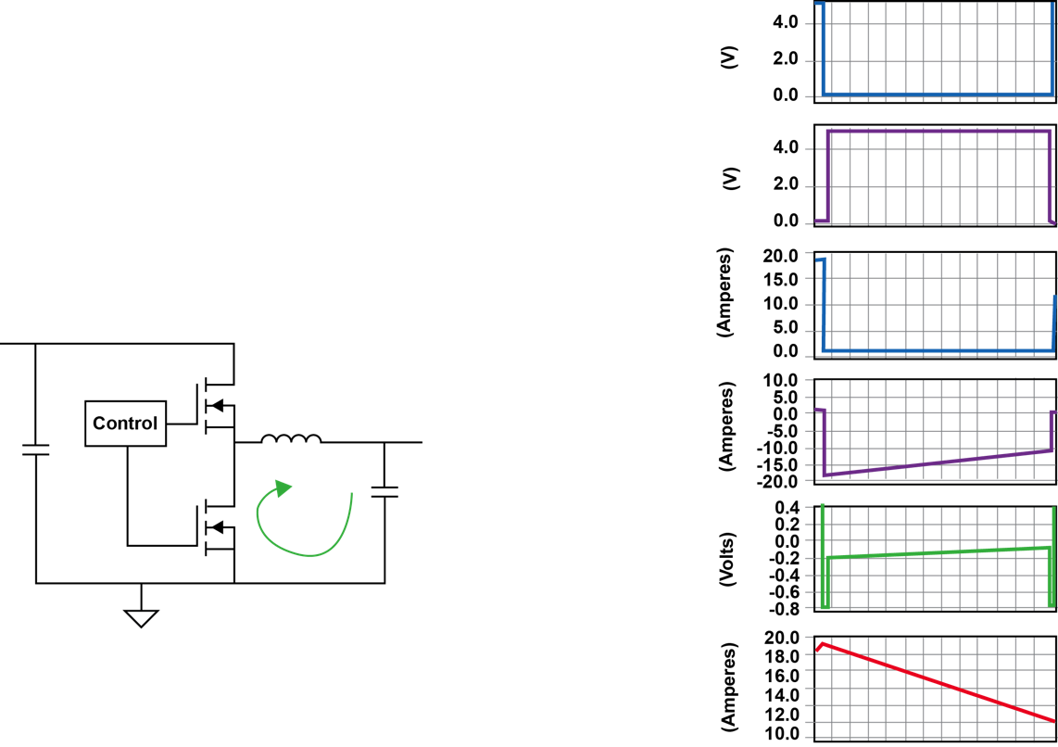
Synchronous Buck Waveforms
Continuous
Conduction
Mode
Inductor reset
HDVR
LDRV
I_{SW}
I_{SR}
SW
I_{L}
1-8
Notes:
Notice that during this interval, the voltage across the RdsON of the SR decays because of the decay of the current in the inductor.

Slide 33
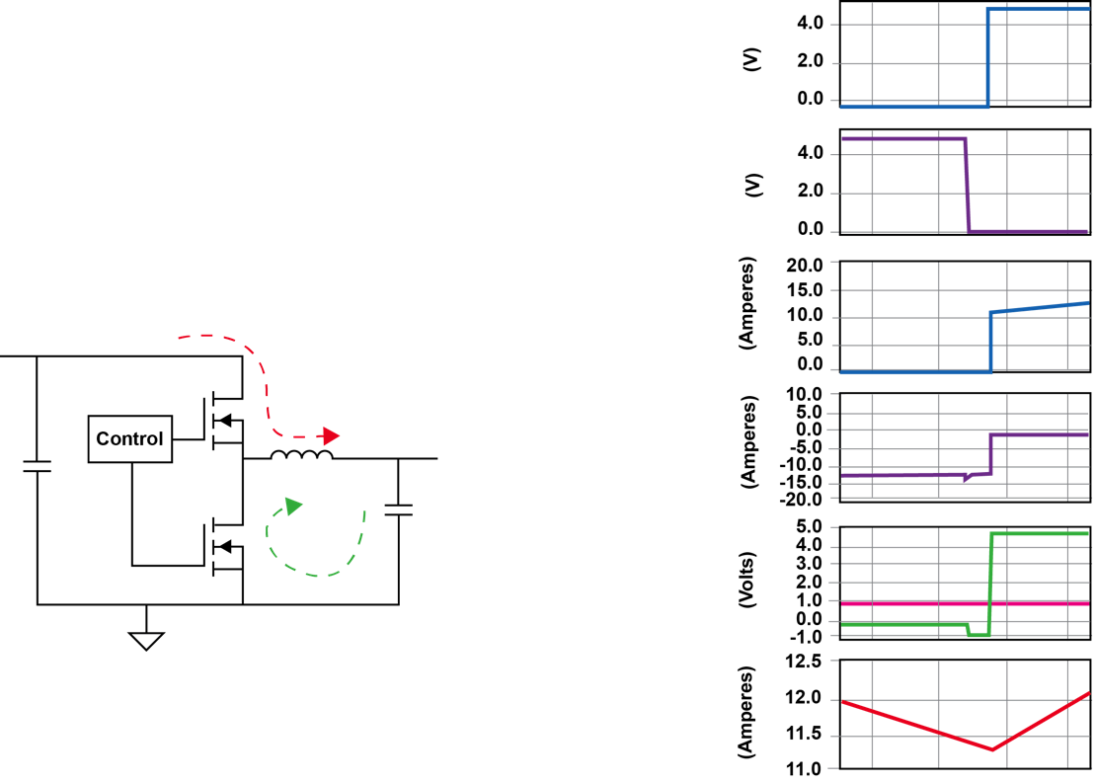
Synchronous Buck Waveforms
Continuous
Conduction
Mode
Transition for next cycle
HDVR
LDRV
I_{SW}
I_{SR}
SW
V_{OUT}
I_{L}
1-9
Notes:
The SR gate signal turns OFF the SR and the inductor current transitions from the channel back to its body diode.
The cycle starts again with the PWM signal turning on the main switch MOSFET.

Slide 34
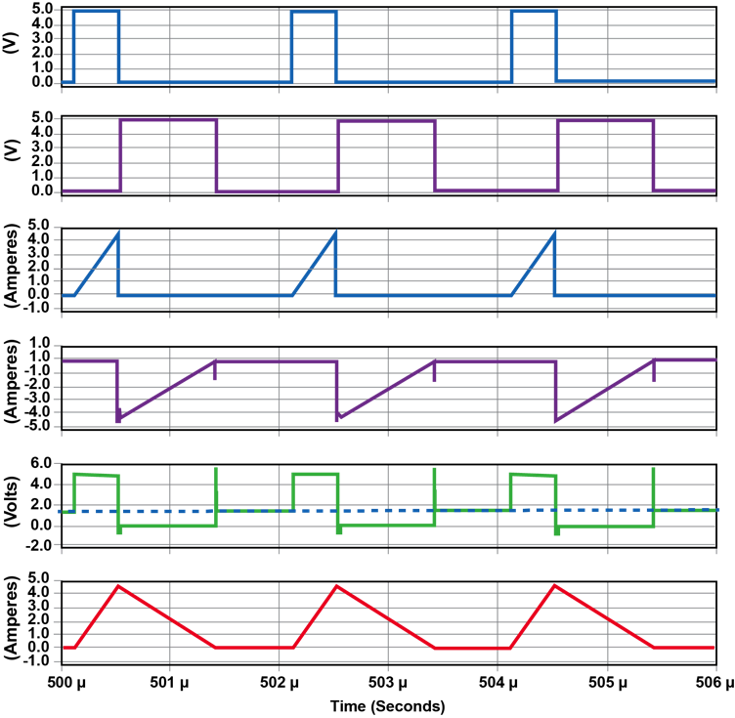
Synchronous Buck Waveforms
Discontinuous
Conduction
Mode
Inductor current flow is discontinuous during the switching cycle
HDVR
LDRV
I_{SW}
I_{SR}
SW
V_{OUT}
I_{L}
1-10
Notes:
One of the key differences in circuit operation between a synchronous and a non-synchronous converter occurs at light loads when the converter’s DC load current is less than half the magnitude of the peak-to-peak ripple current in the output inductor.

Slide 35
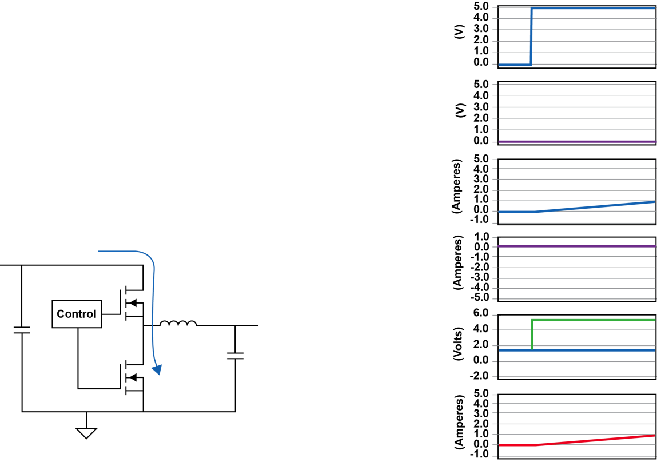
Synchronous Buck Waveforms
Discontinuous
Conduction
Mode
First part is the same as CCM Mode
High side switch turns ON
HDVR
LDRV
I_{SW}
I_{SR}
SW
V_{OUT}
I_{L}
1-11

Slide 36
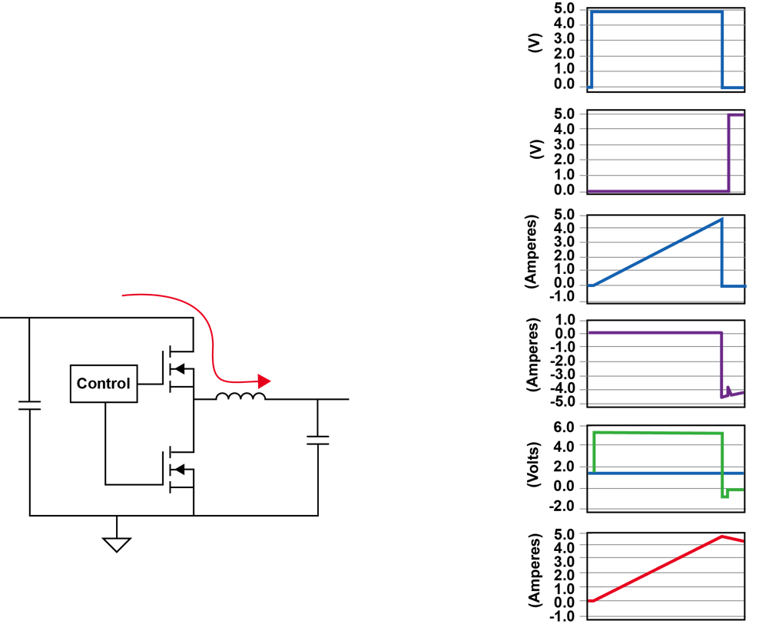
Synchronous Buck Waveforms
Discontinuous
Conduction
Mode
Switch ON
HDVR
LDRV
I_{SW}
I_{SR}
SW
V_{OUT}
I_{L}
1-12

Slide 37
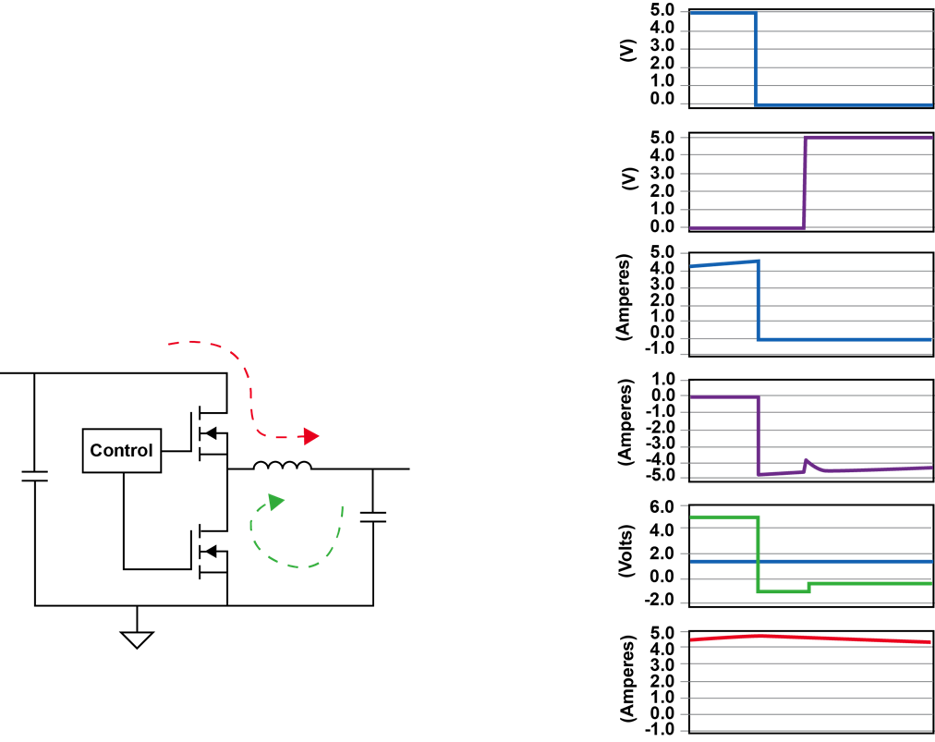
Synchronous Buck Waveforms
Discontinuous Conduction
Mode
Switch turn OFF
SR turn ON
HDVR
LDRV
I_{SW}
I_{SR}
SW
V_{OUT}
I_{L}
1-13

Slide 38
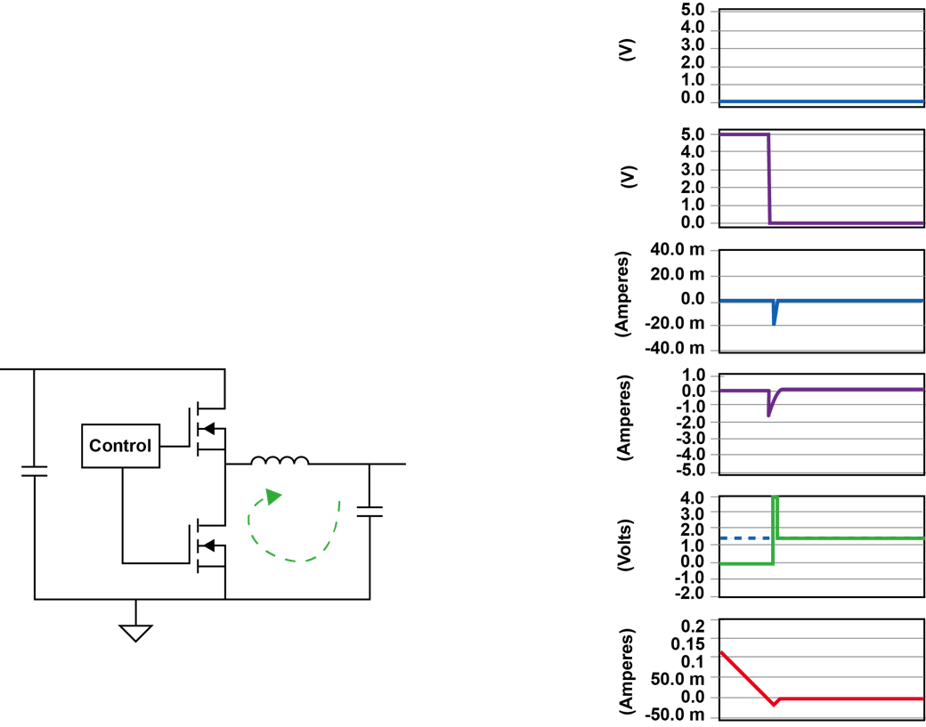
Synchronous Buck Waveforms
Discontinuous
Conduction
Mode
SR turns OFF at zero current in inductor
HDVR
LDRV
I_{SW}
I_{SR}
SW
V_{OUT}
I_{L}
1-14
Notes:
Diode emulator by sensing voltage on the switch node and turning OFF the SR when voltage reaches zero.
Both switches are now OFF and the SW node is high impedance.

Slide 39
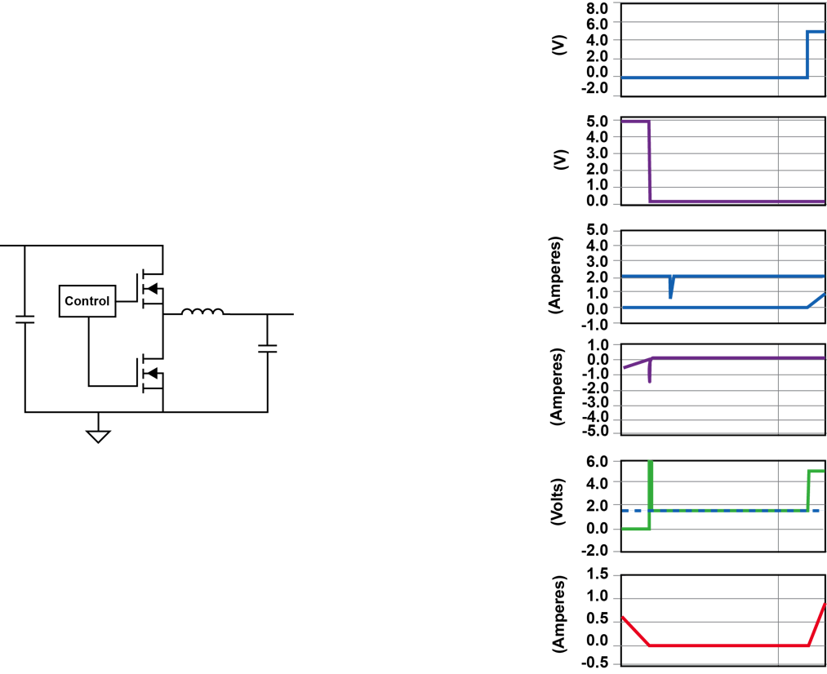
Synchronous Buck Waveforms
Discontinuous Conduction
Mode
Freewheeling interval
HDVR
LDRV
I_{SW}
I_{SR}
SW
V_{OUT}
I_{L}
1-15
Notes:
In a non-synchronous buck converter, when the DC inductor current attempts to go below zero, current no longer flows due to the rectifier diode’s blocking effect.
In this condition, the inductor is running “discontinuous” because current flow is interrupted. When this occurs, the SW node rings up to the output voltage and settles at that level until the next switching cycle begins.
This low energy ringing is generated by the energy in the inductor resonating with MOSFET parasitic capacitance.
NOTE: Duty cycle is based on energy in inductor delivered to the output, not necessarily the duty cycle.

Slide 40
L-C Filter Design
Inductor design for ripple current
Ripple current is generally 10% to 30% of full load current
Capacitor selection for general purpose
Select TYPE based on ESR and ESL
Voltage ripple = impedance x inductor ripple
Select VALUE based on corner frequency of ~1/10 of desired crossover frequency
1-16
Notes:
The inductor and capacitor form a low pass filter, converting a switching waveform into its averaged equivalent (DC) plus a small amount of output noise.
The fundamental portion of the noise is created by the ripple current in the inductor.
The voltage impressed across the inductor ( V_{IN}-V_{OUT}) when the upper switch is on, induces current to build in the inductor. During the time when the upper switch is off, the inductor current decays at a rate determined by the output voltage plus the drop across the rectifier (V_{R}). With fixed frequency operation the design of the inductor is straightforward.
With a variable frequency control approach the filter is also a contributor to the basic function of the converter. Consider a hysteretic control technique: The ON time of the switch is terminated when the output voltage reaches an upper regulation threshold, and the off time is terminated by the output voltage reaching a lower threshold.
A variation of hysteretic control fixes the on time of the switch (called “Constant On Time” or COT control) and requires the off time to vary to maintain regulation. Similar to the hysteretic converter, the output capacitor impedance characteristics must be known to ensure the inductor current rise time is consistent with the ON time for the desired operating frequency and regulation voltage.
Notice that if the input voltage were to vary, the fixed frequency controlled converter would experience a change in duty cycle and a change in the peak to peak ripple. The variable frequency control technique maintains a fixed amount of ripple and results in a change in operating frequency.
When losses increase due to an increase in the load current, the resulting duty cycle increase to maintain output voltage regulation will cause a slight increase in the peak to peak ripple due to the increased duty cycle for the fixed frequency converter. For a Constant On Time converter, the increase in losses due to a load increase tends to increase the operating frequency.

Slide 41
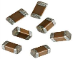
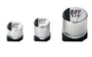
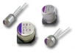
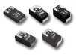
Output Capacitors
Output capacitors will determine output ripple, transient response and greatly impact the compensation
Type of Cap |  | Advantages | Disadvantages
Ceramic |  | Small size, low cost, low ESR, high ripple current rating | DC bias effects, low capacitance, cracking
Aluminum Electrolytic |  | High capacitance, low cost, good for high voltage | High ESR, low ripple current rating, temp issues, large size
Aluminum Polymer |  | High capacitance, low ESR, high ripple current rating | Expensive, fewer manufacturers, large size, voltage rating
Tantalum Polymer |  | High capacitance, low ESR, high ripple current rating, small size | Expensive, fewer manufacturers, voltage rating
1-17

Slide 42
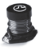
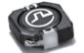
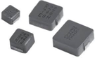
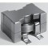
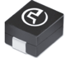
Output Inductors
Output inductors will also determine output ripple, transient response and greatly impact the compensation
Type of Cap |  | Advantages | Disadvantages
Drum Core |  | Low cost, many vendors, high Isat, higher inductances | Can be unshielded, high core loss, high DCR, hard Isat
Molded Core |  | Very high Isat, easy to shape into many sizes, shielded, soft Isat | High core losses, low inductance range
Shaped Core |  | Low core loss, low DCR, high current, shielded, high inductance range | High cost, hard Isat, not suitable for low profile
Power Bead |  | Low core loss, low DCR, excellent for multiphase | Low inductance, hard Isat
1-18

Slide 43
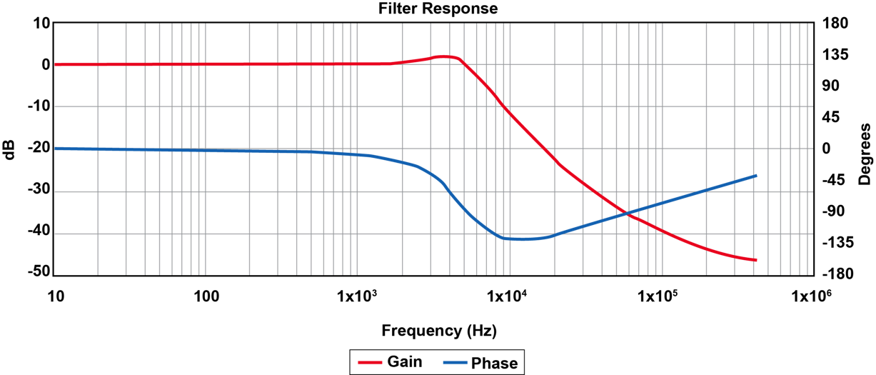
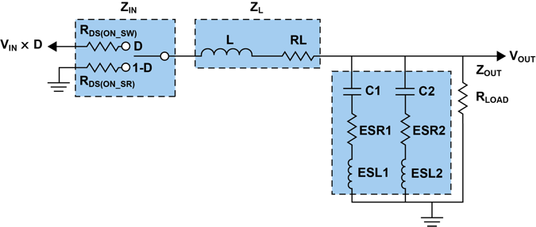
Filter AC Response
Corner frequency ~ 5 kHz
ESR zero ~ 21 kHz
ESL zero ~ 240 kHz
1-19
Notes:
Small signal response of the filter dictate the compensation required by the control scheme as we will see when we discuss details later.
Peak at resonance can vary due to losses and can impact where the loop crossover frequency is selected. Because of the nature of the phase response.
We expect phase to change abruptly at resonance, but is affected by ESR and ESL at upper frequencies. These must be taken into account as well.

Slide 44
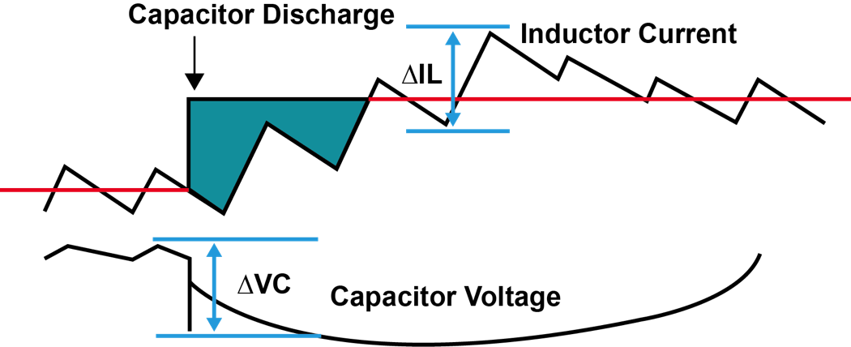
Filter Design for Transient Response
Select L for current slew rate
Select capacitance VALUE based on support of output voltage while current is increasing
1-20
Notes:
Another function of the output capacitors is to act as a “reservoir” for energy during load current transients.
During a step load increase, inductor current will need to build from one level to a higher level.
If the increase in current is faster than the inductor can support in a single switching cycle, then the remaining energy will come from the output capacitors until the current in the inductor can build to the required level.
This means that in an application that requires fast current build up, the ripple current needs to be higher than it otherwise would need to be.
With higher ripple current comes the need for more capacitance to keep the ripple low and to support the output voltage during a load transient. Figure xx show a pictorial description of a step up load transient event.

Slide 45


Minimum Controllable On-Time
Propagation delays limit the minimum controllable pulse width
Below minimum controllable on-time, pulse skipping could occur
Example – TPS40170, min on-time is 100 ns max
V_{IN} = 60 Vmax
V_{OUT} = 5 V or 3.3 V
Frequency = 600 KHz (+10% shift)
For a 3.3 V output, the frequency would need to be lowered to ensure no pulse skipping
1-21

Slide 46
Fixed Frequency vs. Variable Frequency
Fixed frequency operation (Part A)
Synchronize multiple devices
Eliminate beat frequencies between multiple converters
Ripple cancellation to reduce losses in capacitors and PCB traces
EMI peaks consistent at any operating mode
Minimum controllable pulse width
Variable frequency operation (Part B)
Easier to compensate
Off time jitter spreads noise spectrum to reduce EMI average
Faster load transient response
Could be lower cost due to lower component count
1-22

Slide 47
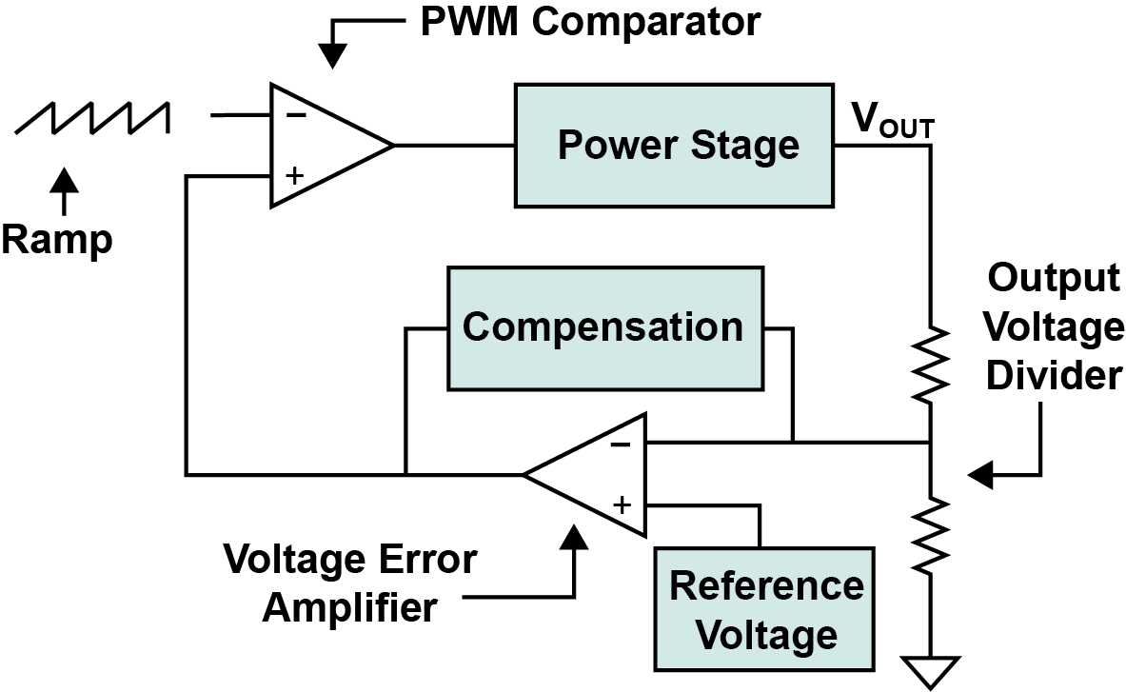
Voltage Mode Control Introduction
1-24
Notes:
Block Diagram for Voltage Mode Control
Three Main Blocks
1. Power Stage
2. Compensation
3. PWM Comparator

